Slide 1
AI Tools Usage Analytics Dashboard
1,050
user records
12
Data Analytics and Visualization: Project Presentation
Course: Data Analytics and Visualization (25CAI202PC201)
School of Computer Science and Artificial Intelligence, SR University
Presented by: U.Harshitha –Enroll number:2503a52943
J.Sahithi Reddy-Enroll number:2503a52936
B.Kalyani –Enroll number:2503a52955
columns
0
missing values
Notes:
Good morning. My project is the AI Tools Usage Analytics Dashboard for the Data Analytics and Visualization course. I used a dataset of 1,050 users with 12 columns and no missing values. I will follow the eight steps in the faculty order: project explanation, data exploration, basic statistics, data wrangling, correlation, Excel visualization, Python visualization, and the final decision. [Before presenting: replace the student name and roll number placeholders on this slide.]

Slide 2
1. Project Explanation
SECTION 1 OF 8
Problem statement
Why it matters
How do the hours, queries and number of AI tools a person uses relate to their productivity, satisfaction, trust and time saved?
AI tools are part of everyday study and work. Knowing which usage patterns go with better outcomes helps users and organisations plan their use.
Objectives
Four questions we answer
Describe the 1,050-record AI usage dataset
Check data quality and prepare the data
Measure relationships between usage and outcomes
Visualize the results in Excel and Python
Draw careful, evidence-based conclusions
1. Daily AI usage vs productivity
2. AI queries vs time saved
3. Trust score vs satisfaction score
4. Number of AI tools vs productivity
1. Understand the problem
2. Explore the data
3. Clean and prepare
4. Analyze and visualize
5. Insights and decision
Notes:
The problem I studied is simple: how does the way people use AI tools relate to how productive and satisfied they feel? I set five objectives, from describing the data to drawing careful conclusions. I focused on four specific questions about usage and productivity, queries and time saved, trust and satisfaction, and number of tools and productivity. The bottom row shows the analytics lifecycle I followed, from understanding the problem to the final decision.

Slide 3
2. Data Exploration: Source and Structure
SECTION 2 OF 8
1,050
Data source
Simulated dataset generated in Python (NumPy, random seed 42), with relationships between variables built in.
Not collected from real respondents.
Not the 2024 Stack Overflow Developer Survey: no column or value structure matches (that survey has no usage-hours or query-count fields).
rows (one per user)
12
columns
File and data types
File: AI_Tools_Usage_Dashboard_Dataset.xlsx (sheets: Dataset, Data_Dictionary)
4 integer columns and 8 decimal columns; all numeric, no text columns
Each row is one user; User_ID is a unique identifier (1 to 1,050)
0 / 0
missing values / duplicate rows
Notes:
This slide explains where the data comes from, and I want to be honest about it. The dataset has 1,050 rows and 12 columns, with no missing values and no duplicates. It is a simulated dataset generated in Python with NumPy using random seed 42, and the relationships between variables were built into the generator. It is not real survey data and it is not from the Stack Overflow Developer Survey. All 12 columns are numeric: 4 integer and 8 decimal.

Slide 4
2. Data Exploration: Key Variables
SECTION 2 OF 8
Variable | Meaning | Unit | Observed range
User_ID | Unique identifier of the user | ID | 1 to 1,050
Age | Age of the user | years | 18 to 60
Experience_Years | How long the user has used AI tools | years | 0.0 to 12.0
Daily_AI_Usage_Hours | Hours per day actively using AI tools | hours/day | 0.1 to 5.8
Num_AI_Tools_Used | Distinct AI tools used regularly | count | 1 to 8
AI_Queries_Per_Day | Prompts sent to AI tools per day | queries/day | 1 to 67
Learning_Hours_Per_Week | Hours per week using AI to learn | hours/week | 0.1 to 14.6
Monthly_Subscription_Cost_USD | Monthly spend on AI subscriptions | USD/month | 0.00 to 41.42
Productivity_Rating | Self-rated productivity gain | 1 to 10 scale | 1.1 to 10.0
Satisfaction_Score | Self-rated satisfaction with AI tools | 1 to 10 scale | 2.0 to 10.0
Trust_Score | Self-rated trust in AI output | 1 to 10 scale | 1.9 to 10.0
Time_Saved_Hours_Per_Week | Estimated hours saved per week | hours/week | 0.0 to 11.4
Observed range is the actual minimum and maximum in the data. Productivity, Satisfaction and Trust are on 1 to 10 scales.
Notes:
These are the 12 variables. User_ID just identifies each user. Age and Experience_Years describe the person. Daily usage hours, number of tools, queries per day, learning hours and subscription cost describe how they use AI. Productivity, Satisfaction and Trust are self-rated scores from 1 to 10, and Time saved is in hours per week. The ranges shown are the real minimum and maximum values in my data.

Slide 5
3. Basic Statistics
SECTION 3 OF 8
Variable | Mean | Median | Mode | Min | Max | Std Dev
Age (years) | 31.04 | 31.00 | 18.00 | 18.00 | 60.00 | 8.22
Experience (years) | 2.67 | 2.30 | 1.40 | 0.00 | 12.00 | 1.92
Daily AI usage (hours/day) | 1.65 | 1.60 | 0.10 | 0.10 | 5.80 | 1.06
AI tools used (count) | 2.66 | 3.00 | 3.00 | 1.00 | 8.00 | 1.34
AI queries (per day) | 20.75 | 20.00 | 1.00 | 1.00 | 67.00 | 14.68
Learning (hours/week) | 3.13 | 2.80 | 1.80 | 0.10 | 14.60 | 1.86
Subscription cost (USD/month) | 5.56 | 1.12 | 0.00 | 0.00 | 41.42 | 7.67
Productivity rating (1 to 10) | 5.75 | 5.70 | 5.30 | 1.10 | 10.00 | 1.42
Satisfaction score (1 to 10) | 6.25 | 6.20 | 5.80 | 2.00 | 10.00 | 1.49
Trust score (1 to 10) | 6.37 | 6.40 | 6.20 | 1.90 | 10.00 | 1.41
Time saved (hours/week) | 4.89 | 4.80 | 3.60 | 0.00 | 11.40 | 2.19
Count = 1,050 for every variable. A typical user spends about 1.6 hours a day on AI, uses 3 tools and saves about 4.8 hours a week. Cost is skewed: median $1.12 against mean $5.56, and 46.1% of users (484) pay $0.
Notes:
This table gives the descriptive statistics for the 11 numeric variables: mean, median, mode, minimum, maximum and standard deviation. The count is 1,050 for every variable because there are no missing values. The highlighted rows are daily usage, which averages 1.65 hours, and productivity, which averages 5.75 out of 10. The subscription cost is skewed, with a median of 1.12 dollars and a mean of 5.56, because 46.1 percent of users pay nothing. Quartiles and variance are also calculated in my Jupyter notebook.

Slide 6
4. Data Wrangling
SECTION 4 OF 8
Data-quality checks
Transformations and preparation
Missing values
0 in all 12 columns
Selected the 12 required columns (Pandas)
usage_band: 7 bands of daily hours (311, 342, 272, 98, 26, 1, 0 users)
tool_group: 1, 2 to 3, 4 to 6, 7+ tools (243, 554, 245, 8 users)
experience_band: 0 to 2, 2 to 5, 5 to 8, 8+ years (442, 499, 84, 25 users)
Excel: DATA sheet formatted as a table with filters and a frozen header; values unchanged
Duplicate rows
0 (also 0 if User_ID is ignored)
Data types
4 integer, 8 decimal: no conversion needed
Value ranges
All valid (ratings 1 to 10, age 18 to 60)
Result: no rows removed and no values filled in. The data was already clean: 1,050 rows by 12 columns before and after.
Notes:
For data wrangling, I first checked data quality. There are zero missing values and zero duplicate rows, the data types are correct, and all values are in valid ranges. So no rows had to be removed and nothing was filled in. The preparation I did was creating categories with the pandas cut function: usage bands, tool groups and experience bands, and then formatting the Excel DATA sheet as a table with filters. I did these steps in Pandas and Excel. Power Query was not used in my files, so I will not claim it. [If your faculty specifically needs Power Query, mention it as future work.]

Slide 7
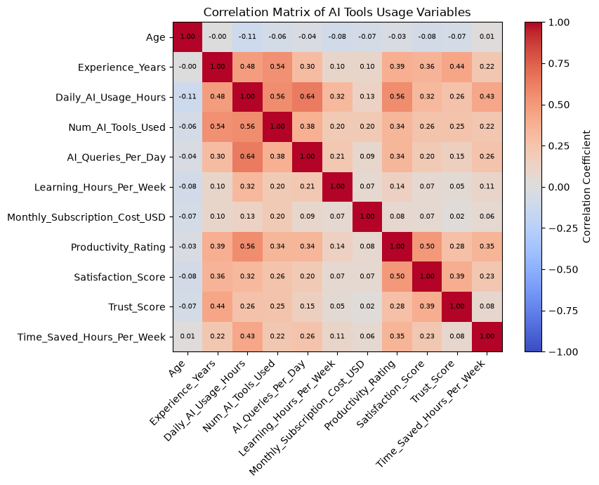
5. Variable Connections (Correlation)
SECTION 5 OF 8
All four pairs are positive; none is strong
Strongest in the matrix: usage and queries (r = 0.64)
Age is almost unrelated to every variable (|r| of 0.11 or less)
Correlation does not prove causation
Rule used: |r| 0.7 or more strong, 0.4 to 0.7 moderate, 0.2 to 0.4 weak, below 0.2 very weak.
Notes:
This heatmap shows the correlation between all numeric variables, and the bar chart shows my four required pairs. Daily usage and productivity have a moderate positive correlation of 0.56. Trust and satisfaction are 0.39, tools used and productivity 0.34, and queries and time saved 0.26, which are all weak positive. The strongest link in the whole matrix is usage with queries at 0.64. Age is almost unrelated to everything. The important point: correlation shows that two variables move together, but it does not prove that one causes the other.

Slide 8
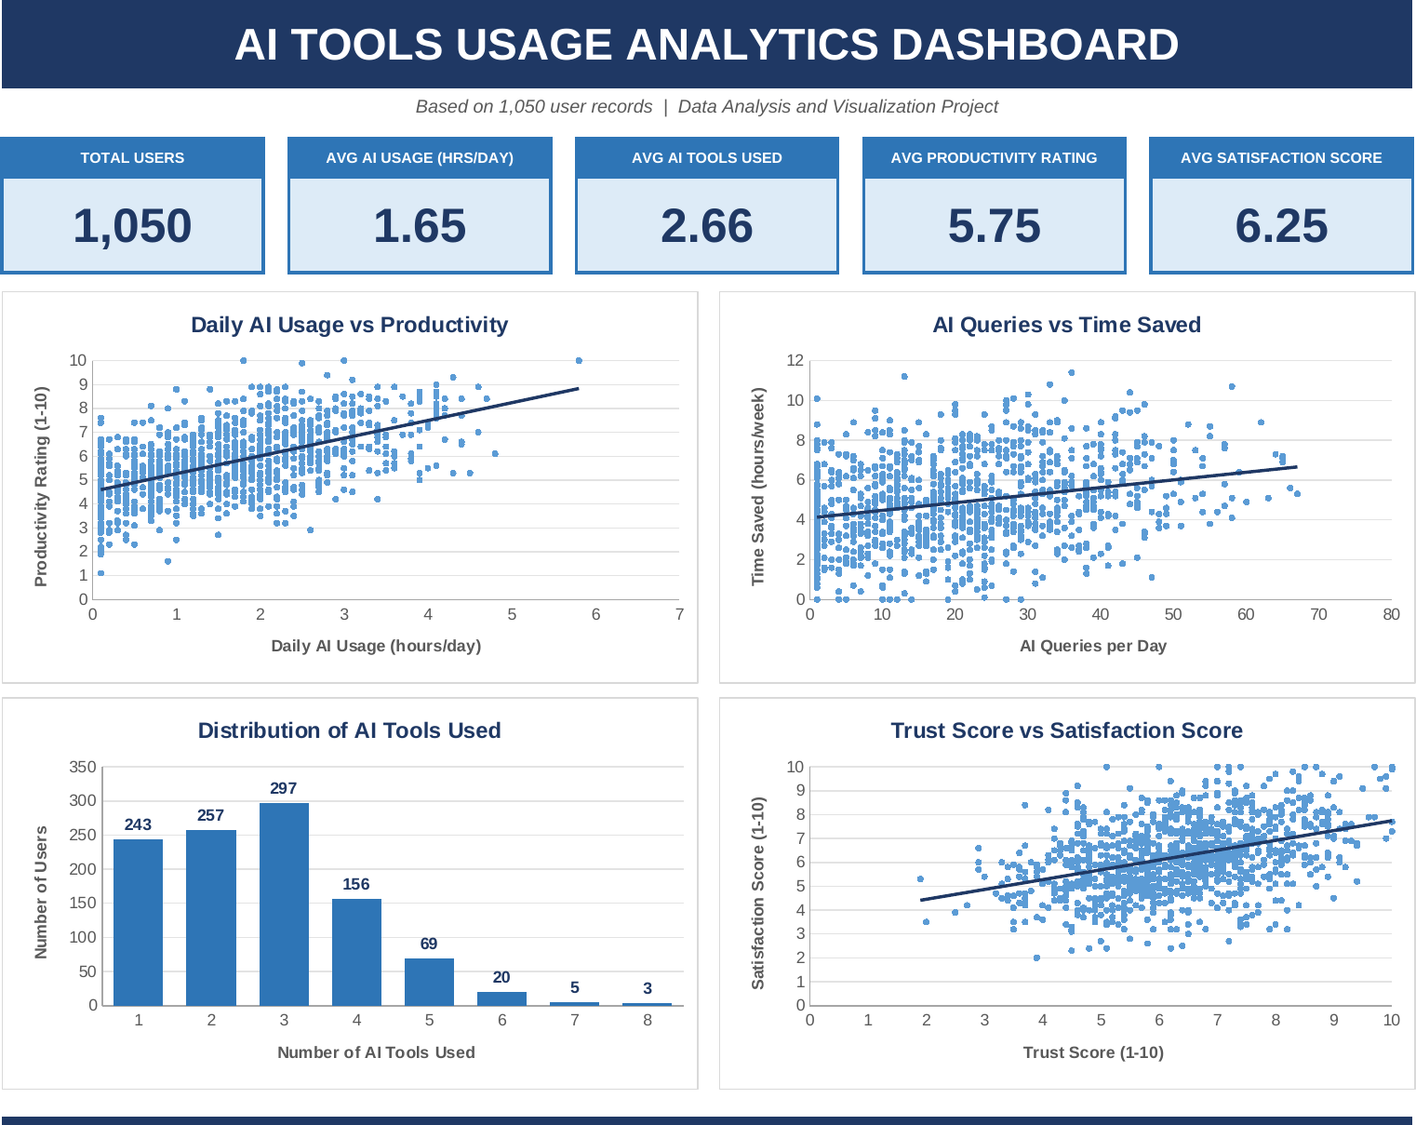
6. Basic Visualization using Excel
SECTION 6 OF 8
What the workbook contains
DATA: Excel table with filters
ANALYSIS: live formulas (COUNT, AVERAGE, MEDIAN, MODE, MIN, MAX, STDEV, CORREL)
DASHBOARD: 5 KPI cards, 4 charts, insights
What the charts show
Productivity rises with daily usage (r = 0.56)
Time saved grows only slightly with queries (r = 0.26)
Most users use 3 tools (297 of 1,050)
Satisfaction rises with trust (r = 0.39)
Notes:
This is my Excel dashboard. At the top are five KPI cards: 1,050 users, 1.65 hours average daily usage, 2.66 average tools, 5.75 average productivity and 6.25 average satisfaction. Below are four charts: three scatter plots with trend lines and one column chart for the number of tools used. All numbers come from Excel formulas on the ANALYSIS sheet, so they update if the data changes. I did not create a PivotTable in this workbook. [The image is a rendering of the real dashboard file.]

Slide 9
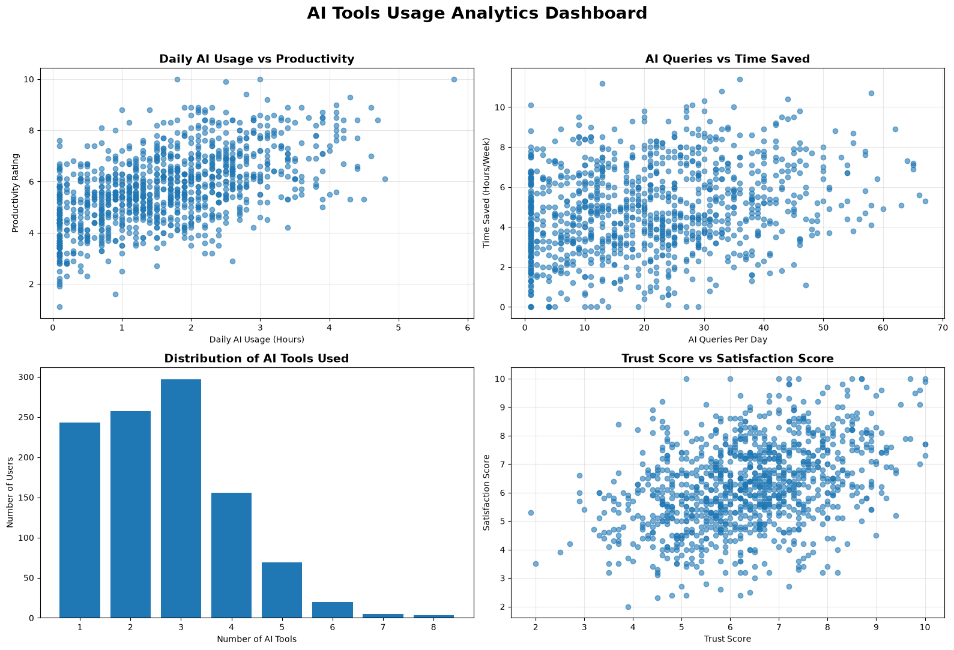
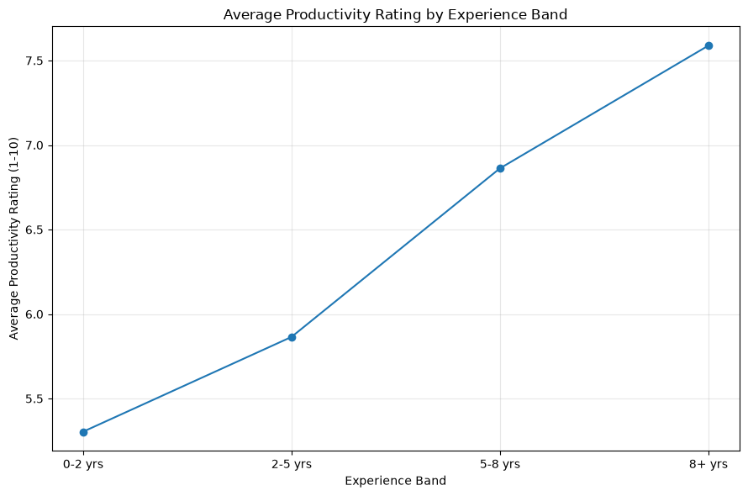
7. Advanced Visualization using Python
SECTION 7 OF 8
Libraries and charts
Pandas, NumPy and Matplotlib
Heatmap, scatter, bar, pie, line and box plots
2 by 2 dashboard of the four key relationships
Average productivity rises with experience: 5.30 (0 to 2 years) to 7.59 (8+ years, only 25 users).
Notes:
Here are the advanced visualizations I made in Python with Matplotlib, using Pandas and NumPy. On the left is a two-by-two dashboard of the four key relationships. On the right is a line chart showing that average productivity increases with experience, from 5.30 for users with 0 to 2 years to 7.59 for 8 or more years. But the 8-plus group has only 25 users, so I treat that as a pattern to check, not a strong result. My notebook uses Matplotlib; I did not use Seaborn.

Slide 10
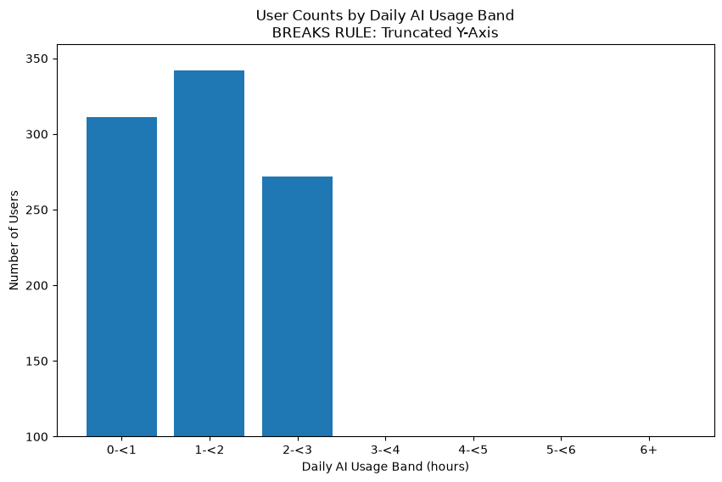
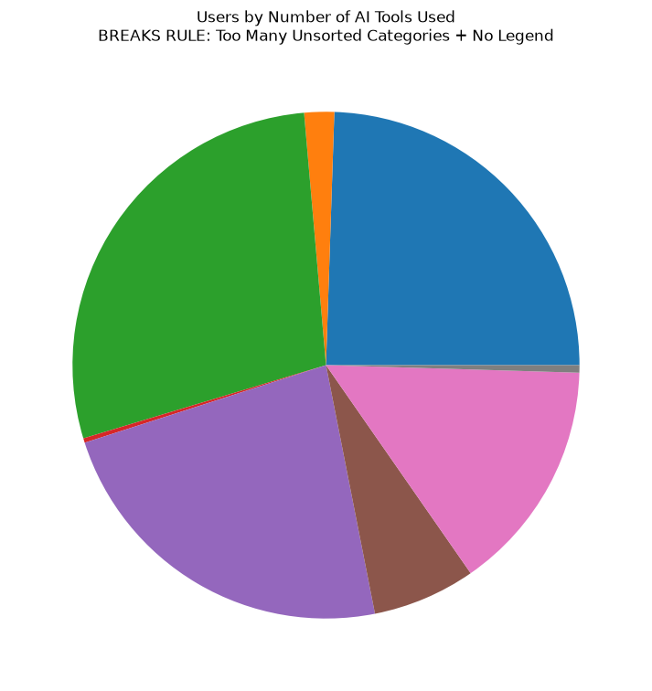
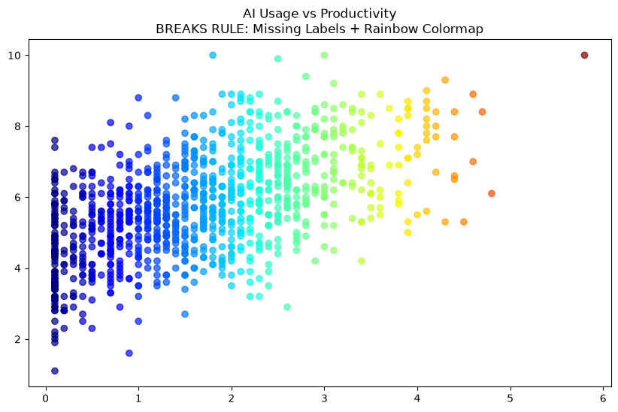
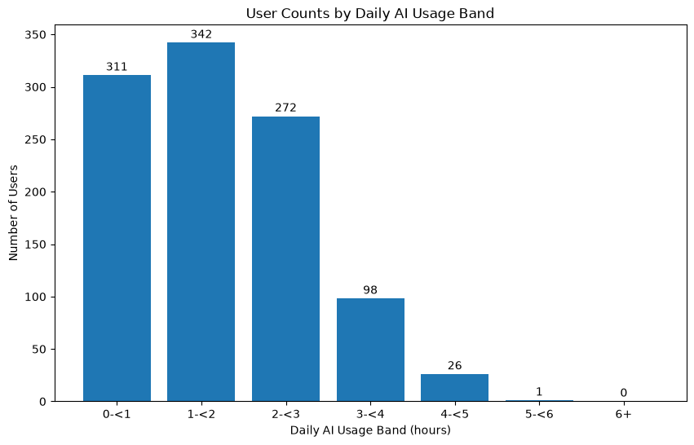
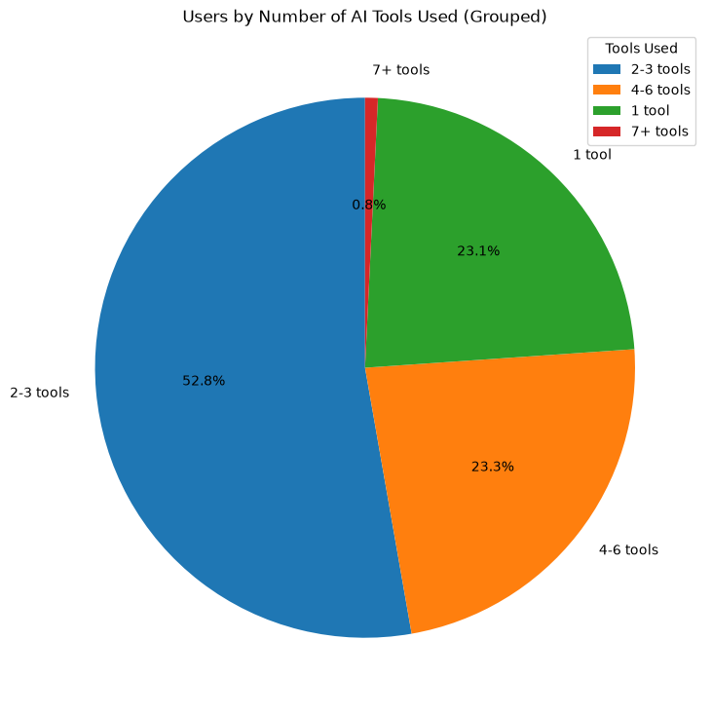
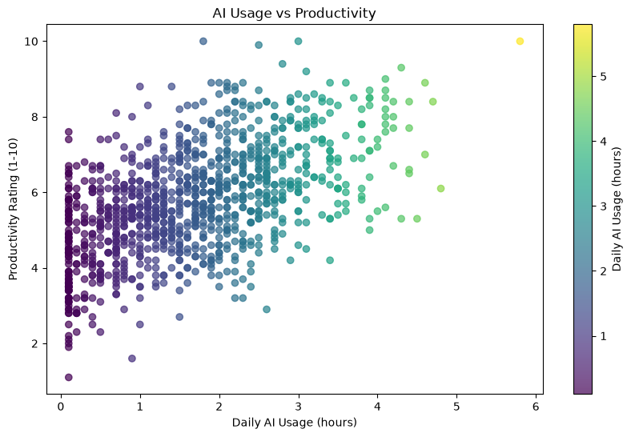
7. Python: Misleading vs Corrected Charts
SECTION 7 OF 8
Misleading: y-axis starts at 100
Misleading: 8 unsorted slices, no legend
Misleading: no labels, rainbow colours
Corrected: zero baseline and labels
Corrected: 4 sorted groups with legend
Corrected: labelled axes, one colour scale
Notes:
In the notebook I also showed how a chart can mislead and how to fix it, which is part of good visualization practice. In the top row, the bar chart has a truncated y-axis that exaggerates differences, the pie chart has too many unsorted slices and no legend, and the scatter plot has no axis labels and a rainbow colour map. In the bottom row I corrected each one: a zero baseline with labels, four sorted groups with a legend, and labelled axes with a single colour scale.

Slide 11
Key Findings
SUPPORTS SECTION 8: FINAL DECISION
r = 0.56
Daily usage and productivity move together (moderate, positive)
75.9%
of users use 3 or fewer AI tools; the most common is 3 (28.3%)
5.30 to 7.59
Average productivity from 0 to 2 years to 8+ years of experience (8+ group: 25 users)
46.1%
of users (484 of 1,050) pay nothing for AI subscriptions
Notes:
These are my key findings. First, daily usage and productivity have a moderate positive correlation of 0.56. Second, the column chart shows most users use three or fewer tools: 75.9 percent, and three is the most common number. Third, average productivity is higher for more experienced users, but the groups above five years are small, with 84 and 25 users. Fourth, 46.1 percent of users, which is 484 people, pay nothing for AI subscriptions.

Slide 12
Interpretation and Limitations
SUPPORTS SECTION 8: FINAL DECISION
What the results mean
What they cannot prove
Heavier daily use goes with higher productivity ratings (r = 0.56), but the scatter is wide: individuals vary a lot
Experience and number of tools rise together (r = 0.54)
Trust and satisfaction are only weakly linked (r = 0.39)
Age shows no clear link to any outcome
Not causation: more usage may not cause higher productivity
Simulated data: relationships were built into the generator, so they show how the analysis works, not how real users behave
Ratings are self-reported 1 to 10 scores at a single point in time
Experience groups above 5 years are small (84 and 25 users)
Future work: repeat the analysis on real survey data; add Power Query preparation, PivotTables and Seaborn plots.
Notes:
Here I explain what the results mean and what they cannot prove. The results show that people who use AI more tend to report higher productivity, but this is only an association. The biggest limitation is that my dataset is simulated, so the relationships were built in by design. That means my analysis shows the method, not real-world behaviour. Also, the ratings are self-reported, and the high-experience groups are small. In future work I would repeat this on real survey data and add Power Query, PivotTables and Seaborn charts.

Slide 13
8. Final Decision and Conclusion
SECTION 8 OF 8
Daily usage vs productivity
Number of tools vs productivity
Moderate positive link (r = 0.56)
Weak positive link (r = 0.34), weaker than hours of use
Trust vs satisfaction
Queries vs time saved
Weak positive link (r = 0.39)
Weak positive link (r = 0.26)
Final decision
In this dataset, hours of daily AI use is the clearest signal linked with higher productivity; the number of tools and queries matter less. These are associations in simulated data, so confirm them with real user data before acting on them.
Notes:
This is my final decision. For the four questions: daily usage and productivity have a moderate positive link of 0.56, while tools and productivity, trust and satisfaction, and queries and time saved are weak positive links. So the clearest signal in this dataset is hours of daily use. My conclusion is that AI usage, productivity and satisfaction move together here, but because the data is simulated and correlation is not causation, the next step is to confirm these findings with real user data.

Slide 14
Likely Viva Questions
PREPARATION
Q1. Where did the data come from?
A simulated dataset generated in Python (NumPy, seed 42). It is not from the Stack Overflow survey or real respondents.
Q2. How is the dataset structured?
1,050 rows (one per user) and 12 numeric columns: an ID plus measures of usage, cost and ratings.
Q3. What cleaning did you do?
Checked missing values and duplicates (both 0), confirmed data types, and made usage, tool and experience bands.
Q4. Which statistics did you calculate?
Mean, median, mode, min, max, standard deviation, variance and quartiles, in Python and in Excel.
Q5. What does r = 0.56 mean?
Usage and productivity rise together (moderate positive). It does not prove usage causes productivity.
Q6. What is in the Excel dashboard?
Five KPI cards, four charts, an ANALYSIS sheet with live formulas, and a filtered DATA table.
Q7. What did you build in Python?
Heatmap, scatter, bar, pie, line and box plots with Matplotlib, plus misleading-versus-corrected charts.
Q8. What are the limitations?
Simulated data, correlation is not causation, self-rated scores, and small high-experience groups.
Notes:
These are likely viva questions with short answers. Be ready to say clearly that the dataset is simulated and generated in Python, and that correlation does not prove causation. If asked about Power Query, PivotTables or Seaborn, say honestly that this project used Pandas, Matplotlib and Excel formulas and charts, and that the other tools are future work.

Slide 15
References
Dataset: AI_Tools_Usage_Dashboard_Dataset.xlsx. Simulated data generated in Python (NumPy, seed 42)
pandas documentation: https://pandas.pydata.org
NumPy documentation: https://numpy.org
Matplotlib documentation: https://matplotlib.org
Microsoft Excel (tables, formulas, charts): AI_Tools_Usage_Analytics_Dashboard.xlsx
Course material: Data Analytics and Visualization (25CAI202PC201), SR University
Thank You
Questions?
U.Harshitha –Enroll number:2503a52943
J.Sahithi –Enroll number:2503a52936
B.Kalyani –Enroll number:2503a52955
Notes:
These are the references for my project: the dataset file, the Python libraries and Excel I used, and the course material. Thank you. I am happy to answer any questions.

